Slide 1
FOX OF HOOD PROJECT STATUS REPORT | MIDSEMESTER
Team B
Manila Aryal, Grace Frizzell, Tamsyn Evezard, Ngoc Bui, Berkan Guven
10/29/2024 6:00pm
https://github.com/ettany/FOH_PSE.git
Notes:
Manila

Slide 2
Roles
Grace: Database & Transaction Lead
Manila: Activity Log & Password Hashing Lead
Ngoc: Visualization & CAPTCHA Lead
Tamsyn: Authentication & API Lead
Berkan: Facial Recognition Lead
Notes:
Manila

Slide 3
Project Info
How our team operates:
Development process used:
Zoom meetings (planning, code reviews, milestone reviews).
WhatsApp & Email (communicating pushed code & updates to github)
In-Person Meetings (informal progress reports before/after classes)
Agile/incremental development
Tools used:
Planning: Asana to assign tasks and measure progress
Development: VS Code, FIGMA (UI visualization), shared GitHub repository
Notes:
Manila

Slide 4
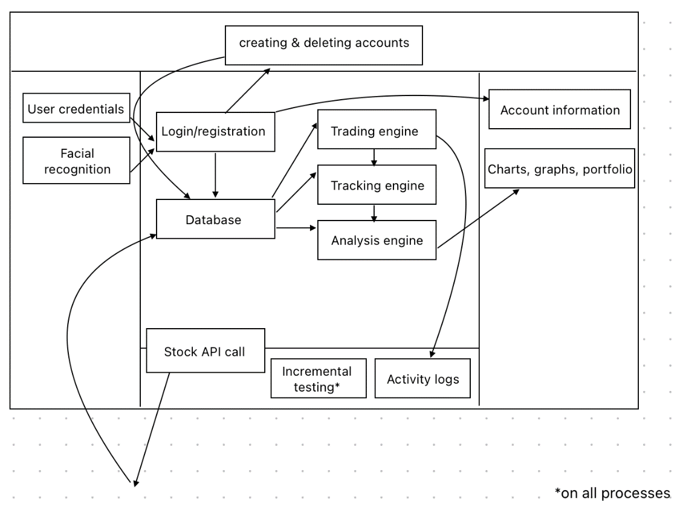
Software Architecture
Notes:
Berkan

Slide 5
FOX OF HOOD – Architecture Overview
User Interface Layer
Frontend: This is what users see and interact with, like the buttons, charts, and stock information. It’s designed to be easy to use.
Login and Security: Users log in with a username and password (CAPTCHA for extra security). Face login is a feature.
Core Application Parts
User Management: Controls user accounts (like creating, editing, and deleting accounts). Admins (special users) have extra control over accounts.
Portfolio Management: This is the main tool for users to manage their stocks. It lets users add, update, and sell stocks in their portfolios.
Charts and Graphs: Creates charts that show stock performance, money trends, and more.
Activity Logging: Records every action users take, like logging in, adding stocks, or making changes, so admins can track usage.
Data Management Layer
Database: A place to save user data, portfolios, logs, and other important information permanently.
External Integrations
Stock Price API: Connects to online service to get the latest stock prices so users see real-time updates.
CAPTCHA Service: Adds extra login security to prevent bots from logging in.
Backend Structure
Backend API: This connects the front-end (user’s screen) with the back-end (where the app’s work happens), so all parts of the app can share data.
Notes:
Berkan

Slide 6
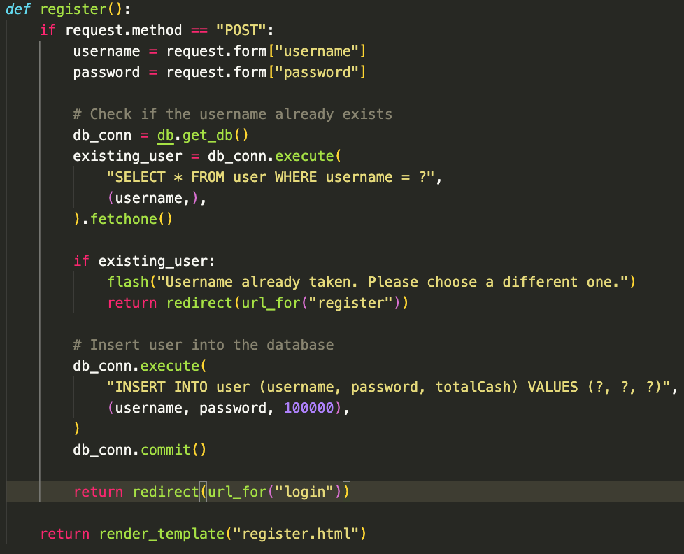
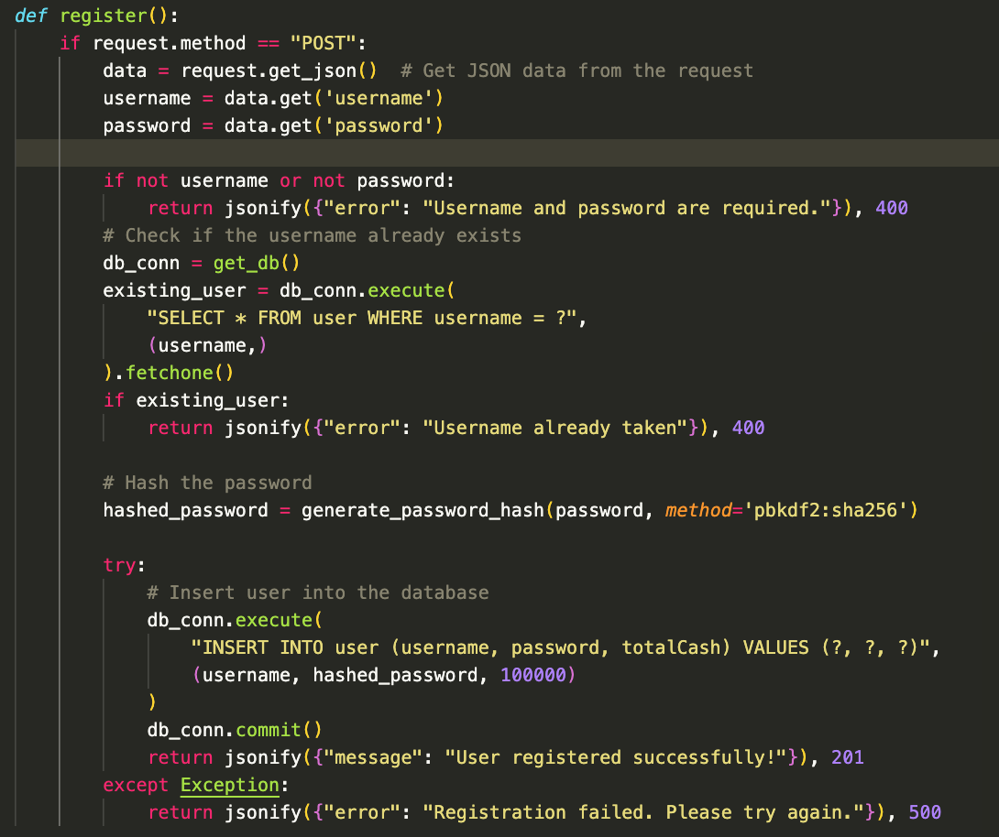
Software Architecture | Traceability
Example: "multiuser application provided by a traditional mechanism (e.g., username and password)"
Authentication | REQ-3: Implement logic for identical username prevention
Notes:
Tam & Ngoc

Slide 7
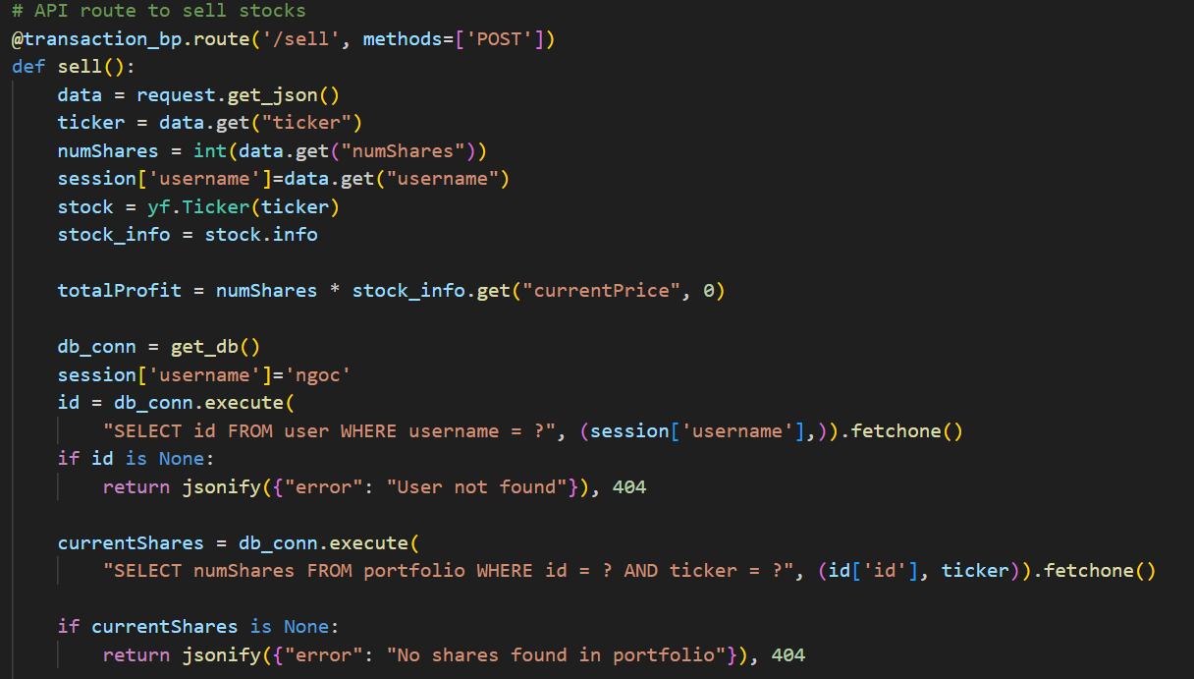
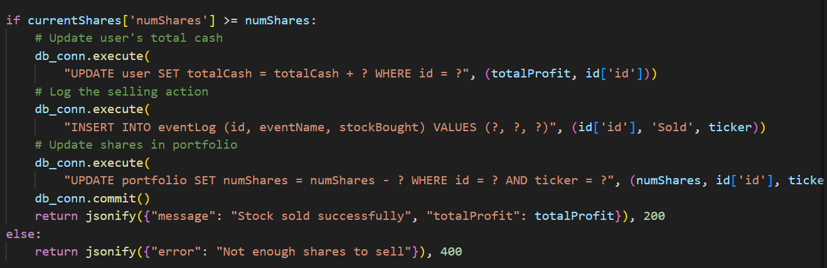
Developed Software | Selling stocks
Access stocks via user input of ticker and number of shares
Check to see if minimum number of shares are owned
Record total profit
Add total profit to cash total
Remove shares from portfolio
Add action to the event log
Notes:
Grace

Slide 8
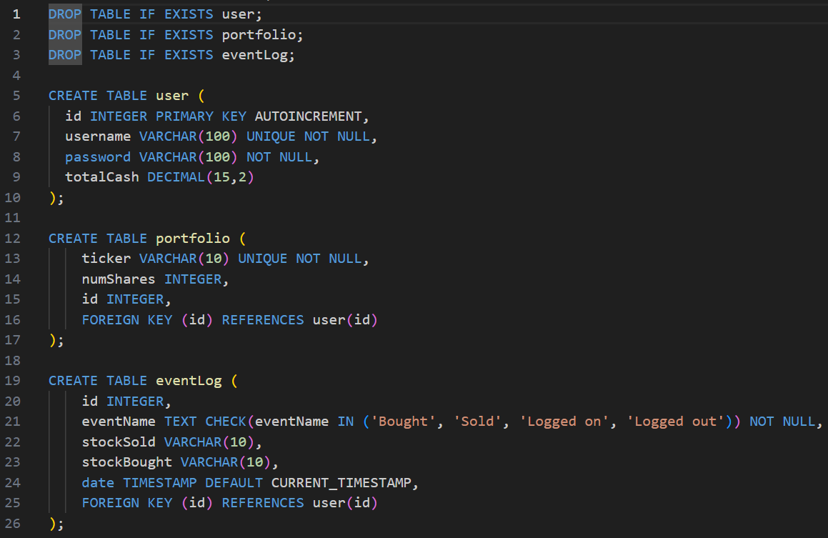
Developed Software | Database
User table
Contains user ID, username, password, and tracks total cash in account
Portfolio
Stores stocks and number of shares owned by the user
Event log
Tracks buying, selling, and log events.
Notes:
Grace

Slide 9
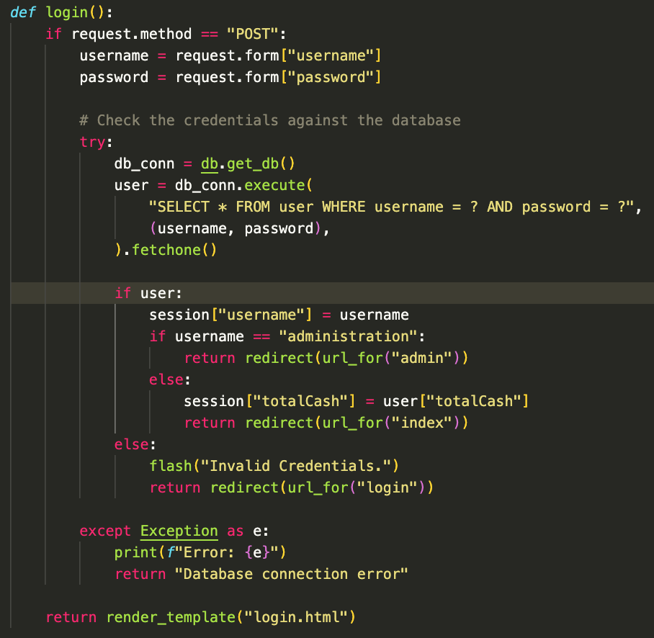
Developed Software
Authentication (username/password)
Role-based access control (user/admin user) to allow/restrict certain users from certain functions
Registration: if username already taken, show flash message
If username not in the database or invalid credentials, show flash message
Note: this login function has since been adjusted to fix the error we were having with the flask session temporarily (explained and shown in demo).
Notes:
Tam

Slide 10
Accomplished Work
Username and password authentication for users and admin that maintains session (functionality included in the register, login, and logout pages)
Password hashing for account security
Working database with user, portfolio, and eventLog tables
Portfolio page
displaying the specific user and their initial balance of $100,000
other hardcoded UI elements for functional visualization
Trade page
displaying updated stock prices for 5 stocks with a table and graph
ability to search for a specific stock and display its details
ability to buy or sell an amount of specific stock
graph of searched stock's performance over the last 30 days
Log page
Hardcoded UI elements for initial visualization
Notes:
Manila

Slide 11
Accomplished Work
How good is it?
Progress measurement: we have achieved all milestones that we defined to be ready and working by this Project Status Report
Well established schedule: although we had a rocky start with progressing with the project and its components, we now have a structured plan and designated leaders within the team which has allowed things to run smoothly recently
Project size:
Backend: about 350 lines of code
Frontend:
Static: about 210 lines of code
Templates: about 367 lines of code
Estimated hours of effort: 60 hours
Developing the product to ensure compatibility:
Python & Flask (backend)
SQL (database schema)
Frontend (HTML, CSS, JavaScript)
API: yahoo finance
Notes:
Grace

Slide 12
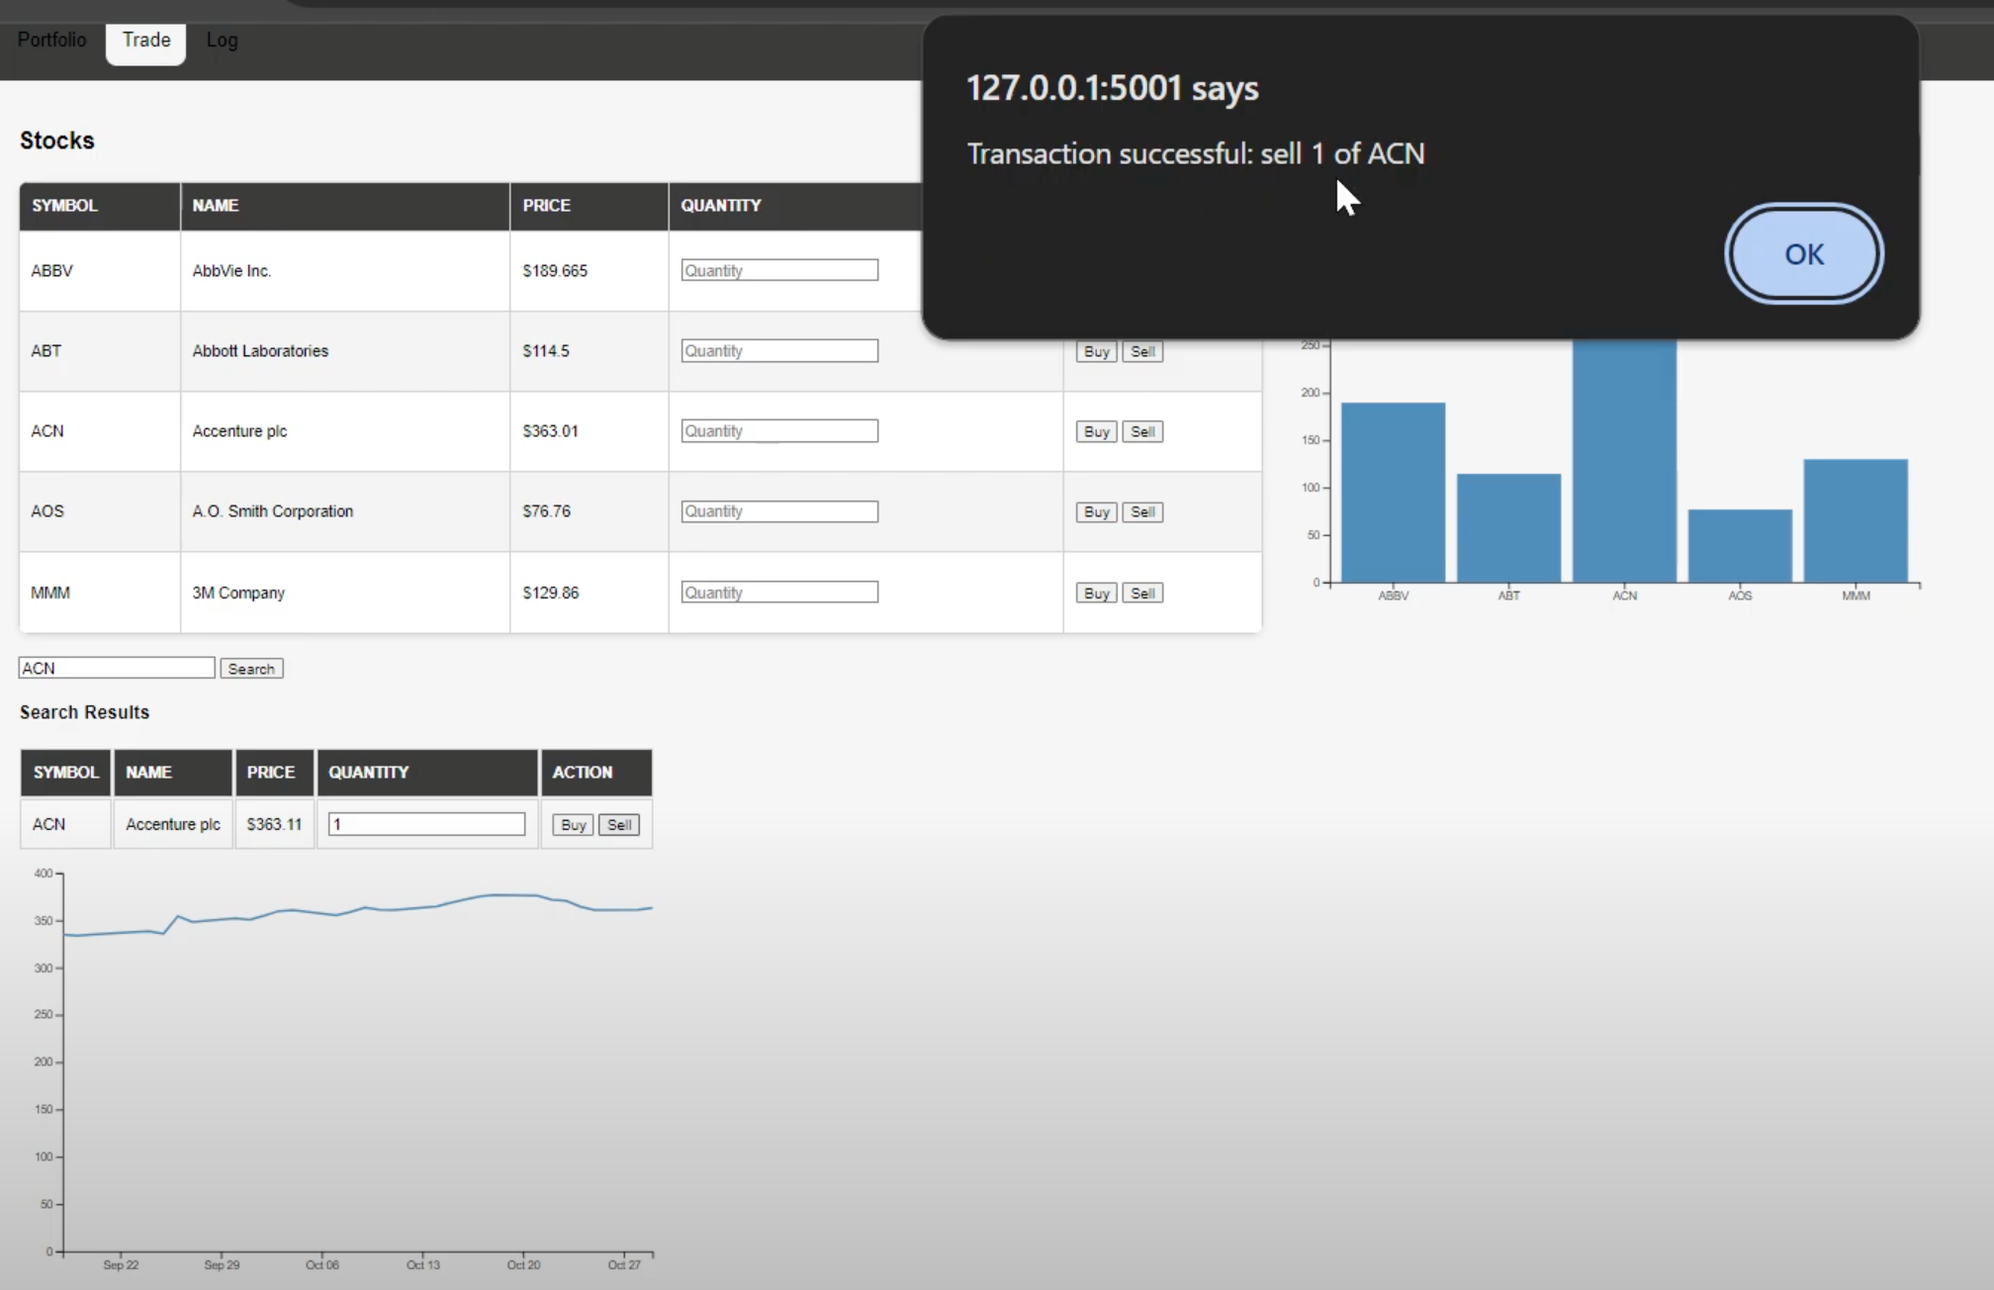
Our Product
3 Key Features:
Buy & Sell,
Stocks (API),
Visualization (graphs)
Notes:
Ngoc

Slide 13
Lessons Learned
What went right?
Using established leadership roles within the project (as shown on slide 2)
Roles allowed us to break the project into manageable chunks and gave team members ownership over their specific roles
What went wrong?
Coordination and collaboration: our initial research and planning stage proved inefficient due to the absence of clearly defined roles
Difficulties implementing the buy and sell functionality & flask session
What would you do differently?
Establish roles and rules earlier in the SDLC
Stick to the languages and frameworks we are most familiar with
Notes:
Tam

Slide 14
Demo
https://www.youtube.com/watch?v=jCZ426may-Q
Notes:
Ngoc

